Slide 1
Intellectual Property Types monitoring and recording behaviour

Slide 2
IP TYPES, RIGHTS AND PROPERTY PROTECTION
Many companies in a variety of industries rely on the enforcement of their patents, trademarks, and copyrights, while consumers can also be assured of quality when they purchasing IP-backed products.
Types of Original Works
Original works are anything choreographed, dramatic, graphic, artistic, literary, or architectural. Examples include pantomimes, books, sculptures, paintings, music, plays, photographs, computer software, and sound recordings.

Slide 3
The 4 types of intellectual property protection.
Patents: A patent is a license or government authority over an invention the owner has legal rights to for a set period. The owner can make, use, and sell their invention. In turn, they publicly disclose information about their invention.
Trademarks: A trademark is any kind of slogan, wording, or logo that represents a brand.
Copyrights: A copyright is a way to protect the authorship of a piece of written work. Written work can include a novel, poetry, a piece of music, or art.
Trade secrets: A trade secret is a technique, formula, design, process, or device that a person or business uses to manufacture a product. It’s not readily ascertainable to others and has inherent value.

Slide 4
WHAT DOES EACH TYPE OF INTELLECTUAL PROPERTY RIGHT PROTECT?
To protect an idea effectively when you launch a product, you need to utilize one or more of these types of intellectual property protection before you commence your marketing activities.
HOW TO SELECT THE MOST SUITABLE PROTECTION ?
The information below highlights how to might determine which one of these intellectual property rights might be best to use to protect an invention.

Slide 5
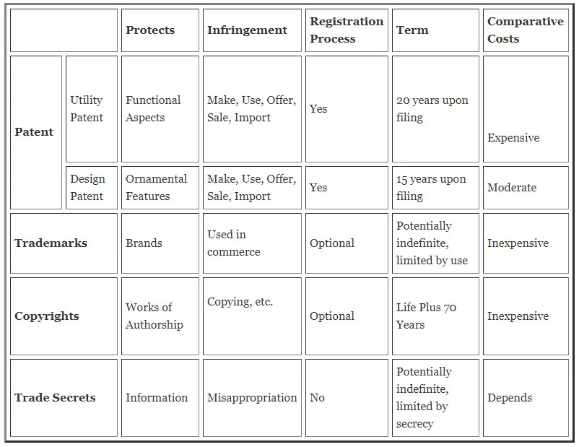

Slide 6
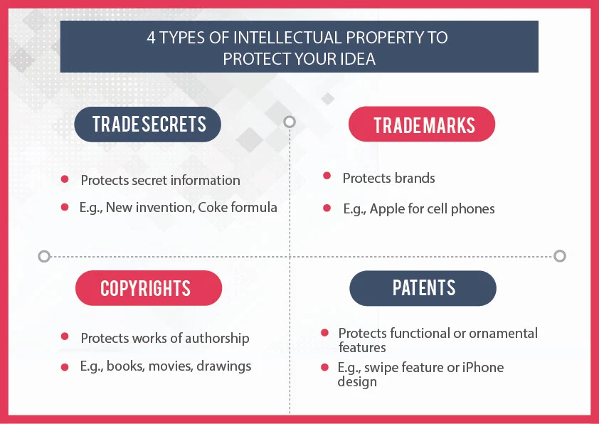

Slide 7
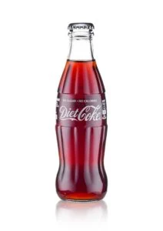
All four types of intellectual property rights can protect one product.
Example,
A bottle or can of Coca-Cola®. The brand, “Coca-Cola” is a trademark.
The formula for the actual soda is a trade secret
copyright law protects the packaging art.
Both (1) a design patent and (2) a trademark (i.e., trade dress) can protect the shape of the Coca-Cola® bottle.

Slide 8
PATENT PROTECTION
Two types of patent are: (US Law)
Utility Patent (Function) protects a useful machine, process, manufacture, and composition of matter.
Design Patent (Aesthetic) protects the ornamentation (i.e., appearance, looks, shape, etc.) of a product.
Plant Patent is for asexually produced plant varieties that use layering or grafting.
The term for a utility patent is generally 20 years from the filing .
The term for a design patent is 15 years from the grant date.

Slide 9
In software and business methods an idea that only constitutes a computer program or a scheme, rule or method for doing business, is not of a technical nature and cannot therefore be patented.
In biotechnology it is possible, for example, to patent genetically modified products.
Methods of human cloning are regarded as unethical and are therefore not patentable.
Medical methods
Devices and products for practising medical methods can be patentable, but the methods themselves are not patentable.
Patents must not prevent doctors from curing and preventing illnesses and also the methods can have different effects on different patients. Therefore, they are not reproducible and not patentable.
Perpetual motion machines
It is not possible to prove that a perpetual motion machine will work for all eternity, therefore it is not patentable.
Morality
It is not possible to get patents for inventions which are contrary to public order or morality.
Mathematical formulae and Sales schemes are not patentable

Slide 10
TRADEMARK PROTECTION
Sounds, colours, smells, and anything else that can bring the product and/or its owner to the minds of a consumer can serve as your trademark. Trademarks should be uniquely identifiable.
The most common types of trademarks are wordmarks, logos, and slogans. If the product configuration (e.g., a Coca-Cola® bottle) or packaging (e.g., Cadbury blue packaging) are non-functional and recall the product’s maker (i.e., source of the product) for consumers, the configuration can be protected and registered as a trademark.
To properly protect a trademark, conduct a search to find out if others are using a similar mark already. If not, then file a trademark application to get your trademark registered.
Registration of a trademark is optional because you accrue trademark rights simply by using the mark in commerce.
When you sell a product or perform service under a brand, trademark law gives you common law trademark rights that you can assert against others in your small geographical region where you used the mark.
To obtain trademark rights, you do not need to register the trademark, but there are significant advantages for doing so, such as nationwide rights and the right to block others from securing a registered trademark with the United States Patent and Trademark Office.
Some examples of trade marks include McDonald’s golden arch, the Facebook logo, and so on.
A trademark can come in the form of text, a phrase, symbol, sound, smell, and/or colour scheme.
Unlike patents, a trademark can protect a set or class of products or services, instead of just one product or process

Slide 11
Trademark Timeframes and Renewals
Trademarks start from the date you file your application. Anyone attempting to file the same trademark after your trademark date receives a rejection letter.
Trademarks last for 10 years and you can renew a trademark every 10 years for perpetuity.
While awaiting application approval, the person or business can use the trademark symbol or ™ to identify their ownership.
After application approval, they can start using the registered trademark symbol or Ⓡ.

Slide 12
COPYRIGHT PROTECTION
Most products have one or more aspects that can be protected with copyright law. For example, the images and words on the product packaging, the label, the product itself, and the webpage can be protected with copyright. These literary and artistic works are protectable under copyright law.
The advantages of copyright registration are that it is inexpensive to secure, and the law allows you to demand attorney fees from infringers. Often, your attorney fees are more costly than your damages due to someone copying your images and words without your authorization. Hence, being able to demand your attorney fees from the infringer is significant leverage that can be used to force infringers to settle early on in the legal process. Without a copyright registration, you would have to pay your attorney fees.
Under copyright laws, copyrights protect original works of authorship that fixed in a “tangible medium of expression.” This definition means that the authored or creative work has been written down on a piece of paper, saved on an electronic storage device (e.g., hard drive or flash drive), or preserved in some other tangible format. Examples of copyrightable works include movies, videos, photos, books, diaries, articles, and software.
Copyright does not protect ideas or useful items.
Although a software program is a functional item, it can be protected by copyrights due to the creativity used in the selection, ordering, and arrangement of the various pieces of code in the software.

Slide 13
You automatically have a copyrighted product in your creative expressions at the time they are fixed in a tangible medium of expression.
The copyright lasts for a very long time. For any work created on or after January 1, 1978, the term of copyright protection is the entirety of the author’s life plus seventy years after the author’s death. For works made for hire as well as anonymous and pseudonymous works, the duration of copyright is ninety-five years from publication or 120 years from creation, whichever is shorter.
Copyright does not need to be registered, but registration does have significant advantages.
You can file your copyright application at www.copyright.gov. Importantly, if your copyright is registered, your attorney fees can be shifted to the infringer as discussed above, and you can ask the judge to award statutory damages. Statutory damages allow a court to impose liability on an infringer for up to 150,000 dollars, even if the damages are significantly less than that amount.

Slide 14
TRADE SECRET PROTECTION
A “trade secret” is any valuable information that is not publicly known and of which the owner has taken “reasonable” steps to maintain secrecy. These include information, such as business plans, customer lists, ideas related to your research and development cycle, etc.
A trade secret is not submitted for approval.
No government body examines, approves, or registers trade secrets.
To establish information as a trade secret, treat the information as a trade secret.
Only those with a need to know should have access to the trade secret information.
Disclosures are done only under a nondisclosure agreement.
When steps are taken to keep information secret, that information becomes a trade secret.
When someone misappropriates a trade secret it needs to be shown in court that the misappropriated information was valuable because of its secrecy, and that steps were taken to keep it secret.
Trade secret protection lasts until the information is no longer valuable, the information is not secret, or the owner no longer takes reasonable steps to maintain its secrecy.
If a person with a trade secret mistakenly reveals it, the information is then considered de facto or no longer private.

Slide 15
Trade secrets can include any type of formula, invention, idea, recipe, work, device, design, or process.
A trade secret gives the person or business a competitive advantage over others and has economic benefits.
Examples include surveys, special algorithms, formulas for soda, customer lists, business plans, and recipes.
Protection for Trade Secrets
Trade secrets receive protections differently than other types of intellectual property.
Examples:
Use of non-disclosure agreements (NDA).
Post-employment restrictive contracts
limiting the access to confidential information for employees.
A business should also consider limiting who can access databases where they store IP information.
Use of digital encryption and physical protections

Slide 16
Explanation of terms with examples:
IP, privacy and ethical infringement.
Intellectual Property law deals with laws to protect and enforce rights of the creators and owners of inventions, writing, music, designs and other works, known as the "intellectual property.“
What is the legal definition of privacy?
In constitutional law, privacy means the right to make certain fundamental decisions concerning deeply personal matters free from government coercion, intimidation, or regulation. ... Under the common law, privacy generally means the right to be let alone.
Privacy gives us a space to be ourselves without judgement, allows us to think freely without discrimination, and is an important element of giving us control over who knows what about us.

Slide 17
Before one can discuss infringement , What are ethical principles?
Ethical principles are universal standards of right and wrong prescribing the kind of behaviour an ethical company or person should and should not engage in. These principles provide a guide to making decisions but they also establish the criteria by which your decisions will be judged by others.
Ethical Infringement would be the breaking of any of these principles.
1. HONESTY is the cornerstone of trust.
2. INTEGRITY refers to a wholeness of character demonstrated by consistency between thoughts, words and actions.
3. PROMISE-KEEP and fulfil commitments.
4. LOYALTY within the framework of other ethical principles. Avoid conflicts of interest and do not use or disclose information learned in confidence for personal advantage.
5. FAIRNESS. Strive to be fair and just in all dealings.
6. CARING. Demonstrate compassion and a genuine concern for the well-being of others.
7. RESPECT treat everyone with respect and in the way you would like to be treated.
8. LAW ABIDING. Obey the law.
9. COMMIT TO EXCELLENCE. Pursue excellence in performing duties, be well-informed and prepared, and constantly endeavour to increase proficiency in all areas of responsibility.
10. LEADERSHIP. Help to create an environment in which principled reasoning and ethical decision making are highly prized.
11. REPUTATION AND MORALE. Build and protect and build the company’s good reputation and the morale of it’s employees.
12. ACCOUNTABILITY. Be accountable.

Slide 18
Use of monitoring methods and recording of behaviour.
WHAT TO MONITOR AND LOOK FOR ?
Changing behaviour patterns, expressions of anxiety, provocative or threatening behaviour, intent to harm others, intent to damage property, apathy, rejection of peers, irrational behaviour, depression, bullying, friction with others, serious and chronic complaints, refusal to cooperate, loss of interest and withdrawal, threatened suicide, hyperactivity, racism, language barriers.
How is behaviour monitored?
Need to narrow down the problem.
Choose the most important/interesting behaviour and decide to monitor that first.
Observe quality and quantity of target behaviour components.
Reflect on your own experience of a particular behaviour, including how that behaviour makes you feel.
Reward successful behaviour and penalise poor behaviour

Slide 19
Formal and informal methods to observe and monitor behaviour
Monitoring behaviour is the process of observing and recording information about clients that relates to their wellbeing.
This does not mean that you are required to take a ‘big brother’ approach. In other words, it is not about watching every move that a client makes and recording their every action.
It has more to do with making sure that we provide the necessary services at the right time and to suit the needs of the client. It also lets us be ‘one jump ahead’ in anticipating changes in the needs of clients and is a way of telling if a client is not behaving in a positive way.
We monitor behaviour so that we can:
prevent small problems from becoming large problems
help people cope with problems and issues as they arise
provide appropriate support eg counselling, when it is needed
provide better quality service.

Slide 20
Communication of ethical policy
Work and methods involved in maintaining, development and implementation of IP, ethics and privacy policies and procedures

Slide 21
First impressions
When we first meet people we usually make judgements about them based on their appearance and the way they speak and act. These impressions might be right or wrong and may change as we interact with them. When we are making judgements about the behaviour of other people we usually base our opinions on what we think is right and wrong and what the people around us think is normal. However, our ideas of ‘normal’ are based on our own personal experiences with own families and circle of friends.
It might be useful to think of behaviour as being usual or common rather than normal, because what is considered ‘normal’ depends a great deal on where we are.
For example, in some cultures it is usual for people to eat while sitting on the floor, whilst this is not so common in European cultures.
When we are monitoring behaviour it is important to keep in mind the differences between cultures as well as having some idea what is the ‘usual’ behaviour for a particular instance.

Slide 22
Values
We all come to the workplace with our own values and ideas about the world. It’s important that we don’t let our personal values impact on the way we interpret the behaviour of our clients. Clients have the right to professional service regardless of where they come from, what they wear, or the life choices they have made.
Being fair and consistent
It is essential that you be fair and consistent when monitoring the behaviour of clients. This means not letting our own personal biases and opinions impact on the way we interpret the behaviour of clients. There are a number of ways we can help ourselves to do this. Here are a few suggestions. You should be able to add a few of your own to this list.
Identify our own values and biases before coming into the workplace.
Try not to make value judgements about what is right and wrong for other people.
Try to imagine what life is like from the client/worker perspective.
Obtain information about clients from as many sources as possible.
Check whether your observations are similar to those of your colleagues or other health care professionals.
Record only factual information about clients/worker, not opinions.
Respond to client/worker in a professional way regardless of your opinions about their behaviour.
Keep in mind that client/worker have the right to dignity and respect. This includes respecting their choices.
Describe behaviour rather than labelling behaviour.

Slide 23
Decisions on action are consistent with all available evidence and organisational practice/procedures
The policy and procedure manual for your organisation should have guidelines for dealing with unacceptable behaviour and, in particular, for dealing with crisis situations. If you have access to a policy and procedure manual you should check to see what the guidelines are. They should make it clear what the protocols are for dealing with abusive or aggressive client/workers or with bomb threats . It is your responsibility as a worker to be aware of the relevant policies and to follow them.
IMPORTANT POLICIES:
Access and Equity Policy
Duty of Care
Safety and Security
Critical Incidents
Occupational Health and Safety (OHS)
Code of Conduct
Complaints Policy
Legislative and statutory obligations including recording and reporting incidents.
Management is responsible for setting up processes to deal with critical incidents and for documenting what happens. You should have a back-up person available for emergencies and you need to know their number and how to contact them. Example. floor manager, or after hours manager. The organisation should provide incident report forms to be completed by you and by anyone witnessing the incident.
Management is also responsible for providing debriefing, support and counselling should you be involved in a crisis situation.

Slide 24
SCENARIO 1
You are a worker at a small private hospital in the sterilising department. Mary has been working in the sterilising department part time for 8 months. The last few weeks you have notice her behaviour has change Mary has become agitated, restless. She has three children and her partner is in prison. Recently, Mary was arrested for swearing at the police. She went to court yesterday and was put on a six month good behaviour bond. She has come to your department this morning and is hurling abuse at you, the other staff . Despite her light sentence, she feels that the police have targeted her because they know that her husband is in prison. She thinks that you and your organisation are part of the plot to make her life difficult. You can see that her anger is escalating.
How would you handle this situation?
What is the first thing you would do?
What other information might you need in order to cope with Mary’s behaviour?
What are your responsibilities in this situation?
What should management do?

Slide 25
Managers and leaders should be well equipped to not only identify such behaviour, but also handle any possible complaints.
Employers are responsible for preventing bullying and any form of harassment in the workplace and are, therefore, liable for any bullying suffered by an employee(s).
By creating a clear Code of Conduct for employees to adhere to from the outset, an environment of respect and open communication is developed and nurtured within an organisation.
It will also help to create a sense of camaraderie between employees, meaning that if an employee was to exhibit unacceptable behaviour, more people are likely to speak out against it.
These policies and the organisation’s Code of Conduct should be introduced to employees at the induction stage and reiterated throughout the term of employment.
You don’t want to create a culture of fear, but employees should know that there are consequences for bad behaviour.

Slide 26
Create a safe, welcoming workplace culture
As with any workplace culture, it is important that the principles start from within.
Establishing a strong corporate vision which encompasses internal values and staff engagement, as well as external ones, will help to create a culture to which everyone is attuned.
Communication should be a key component of an effective culture.
Employees should feel able to freely open up and discuss any issues they may have within the workplace, no matter how serious in nature.
There should be zero tolerance of bad behaviour within an organisation and this should create a whistle-blowing policy, where all employees feel able to report such behaviour whether they have experienced it or witnessed it.
Not only should employees feel free and comfortable to talk about such instances, it should also be clear to them who they should be talking to.
By opening clear communication channels for complaints, employees will feel they can share anything they believe is unprofessional.

